Slide 1
Archive prototype
Bojana Tasić, bojana.tasic@fors.unil.ch, FORS
SERSCIDA Dissemination meeting,
Sarajevo, Bosnia and Herzegovina
May 29, 2014

Slide 2
Introduction
Deliverable 5.3: Report on prototype database, June 30
Workflow described using OAIS model

Slide 3
OAIS model

Slide 4
Elements
Functional entities
Actors
Information packages

Slide 5
Functional Entities

Slide 6
Actors

Slide 7
Actors
Producers
  Person, agency or a system, that deposit data (data producers, depositors, researchers)
Management
  People who work in the archive (data managers, archivists, programmers, database managers, data centre managers)
Consumers
  People who use the data (readers, researchers, academics, public, user community)

Slide 8
Communication with Actors
Develop preservation strategies
Develop standards
Design IP
Monitor the community
What do they want?
Monitor technology
How can we deliver data?
Negotiate with Producer
Audit submissions
Agree format standards
Define access permission
Define metadata for SIP
Support service
How they can access the data?
What file formats do they want?

Slide 9
Communication tools
General communication
  Website
  Mailing lists
  Direct contact
Specific communication
  RT: Request Tracker – used to record all the communication in Ingest process

Slide 10
Information packages

Slide 11
Information packages
Submission Information Package
Archival Information Package
Dissemination Information Package

Slide 12
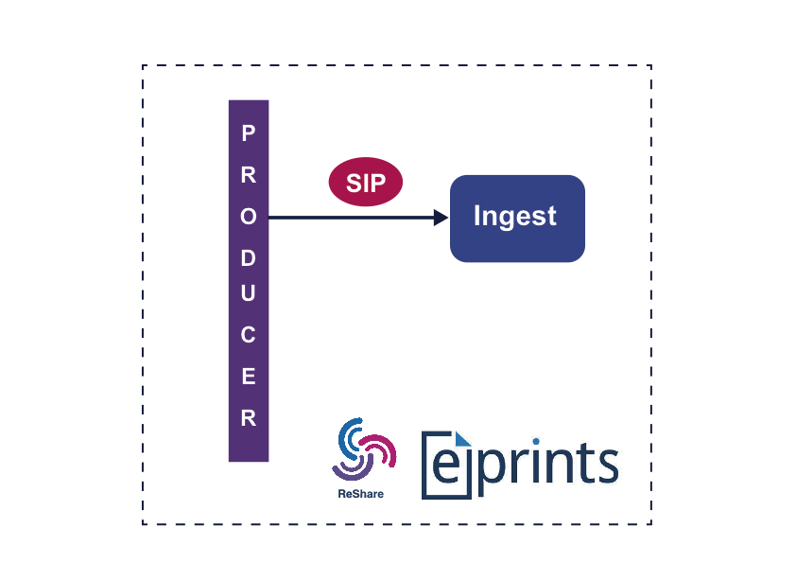
Ingest
EPrints + ReShare
Research data repository
Expanded metadata profile (DDI)
Developed by UKDA

Slide 13
Ingest
Log receipt
Virus Scan
Checksum creation
Generate UID
Identify file formats
Validate file formats
Extract technical metadata
Access permission

Slide 14
Data Management and Archival Storage
Long term reliable storage
File and format classification
Risk analysis
Action and migration of formats
Security, disaster recovery

Slide 15
Access
Process dissemination request
Add Descriptive Information
Generate the DIP for Nesstar
Deliver the response

Slide 16
Access
Add/change descriptive metadata
Basic technical metadata
Change file format to the one Consumer expects
Add rights metadata

Slide 17

Access tool

