Slide 1



Archive prototype
"Data Archives/Services and Research Community"
Bojana Tasić,
The Swiss Foundation for Research in Social Sciences (FORS)

Slide 2
Introduction
Deliverable 5.3: Report on prototype database, June 30
Workflow described using OAIS model

Slide 3
OAIS model

Slide 4
Elements
Functional entities
Actors
Information packages

Slide 5
Functional Entities

Slide 6
Ingest
Receive submission
Quality assurance
Transform SIP into AIP
Extraction of descriptive metadata
Transfer of the AIP to Data Management and Archival Storage

Slide 7
Data management
Manage metadata in database
Keep a record of actions
Manage UIDs
Perform queries on databases
Generating reports

Slide 8
Archival Storage
Store AIP (physical files)
Media migration
Media replacement
Disaster recovery
Security

Slide 9
Preservation planning
Monitor the environment
Provide recommendations and preservation plans
Policies
Technology watch

Slide 10
Administration
Auditing submissions
Negotiating with Producers
Managing the configuration of the system
Ensure that the system conforms with policies

Slide 11
Access
Services and functions that support Consumers
Generate and deliver DIP

Slide 12
Actors

Slide 13
Actors
Producers
  Person, agency or a system, that deposit data (data producers, depositors, researchers)
Management
  People who work in the archive (data managers, archivists, programmers, database managers, data centre managers)
Consumers
  People who use the data (readers, researchers, academics, public, user community)

Slide 14
Communication with Actors
Develop preservation strategies
Develop standards
Design IP
Monitor the community
What do they want?
Monitor technology
How can we deliver data?
Negotiate with Producer
Audit submissions
Agree format standards
Define access permission
Define metadata for SIP
Support service
How they can access the data?
What file formats do they want?

Slide 15
Communication tools
General communication
  Website
  Mailing lists
  Direct contact
Specific communication
  RT: Request Tracker – used to record all the communication in Ingest process

Slide 16
Information packages

Slide 17
Information packages
Submission Information Package
Archival Information Package
Dissemination Information Package

Slide 18
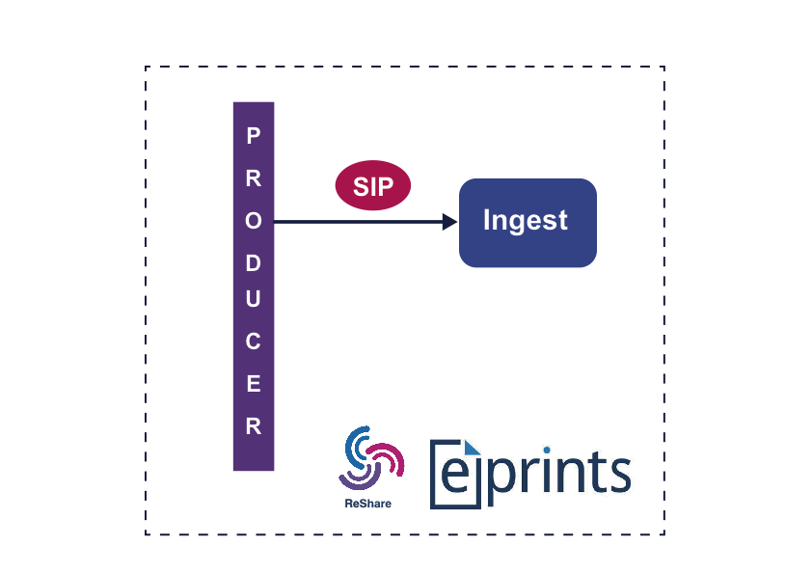
Ingest
EPrints + ReShare
Research data repository
Expanded metadata profile (DDI)
Developed by UKDA

Slide 19
Ingest
Log receipt
Virus Scan
Checksum creation
Generate UID
Identify file formats
Validate file formats
Extract technical metadata
Access permission

Slide 20
Data Management and Archival Storage
Long term reliable storage
File and format classification
Risk analysis
Action and migration of formats
Security, disaster recovery

Slide 21
Access
Process dissemination request
Add Descriptive Information
Generate the DIP for Nesstar
Deliver the response

Slide 22
Access
Add/change descriptive metadata
Basic technical metadata
Change file format to the one Consumer expects
Add rights metadata

Slide 23

Access tool

Slide 24
Thank you for your attention
Bojana Tasić,
The Swiss Foundation for Research in Social Sciences (FORS)

